Slide 1
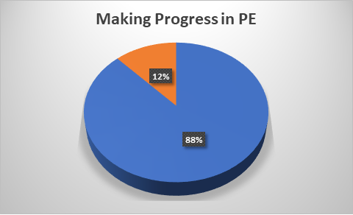
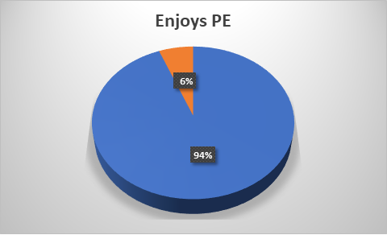
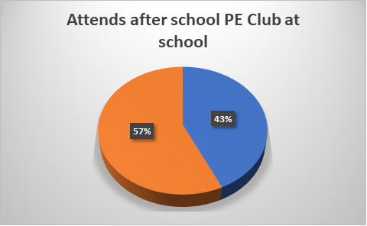
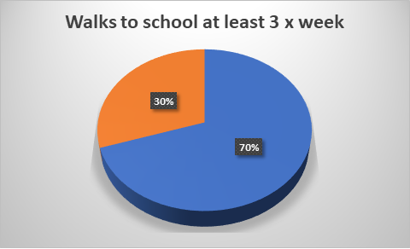
PE & Sports
2024-2025

Slide 2
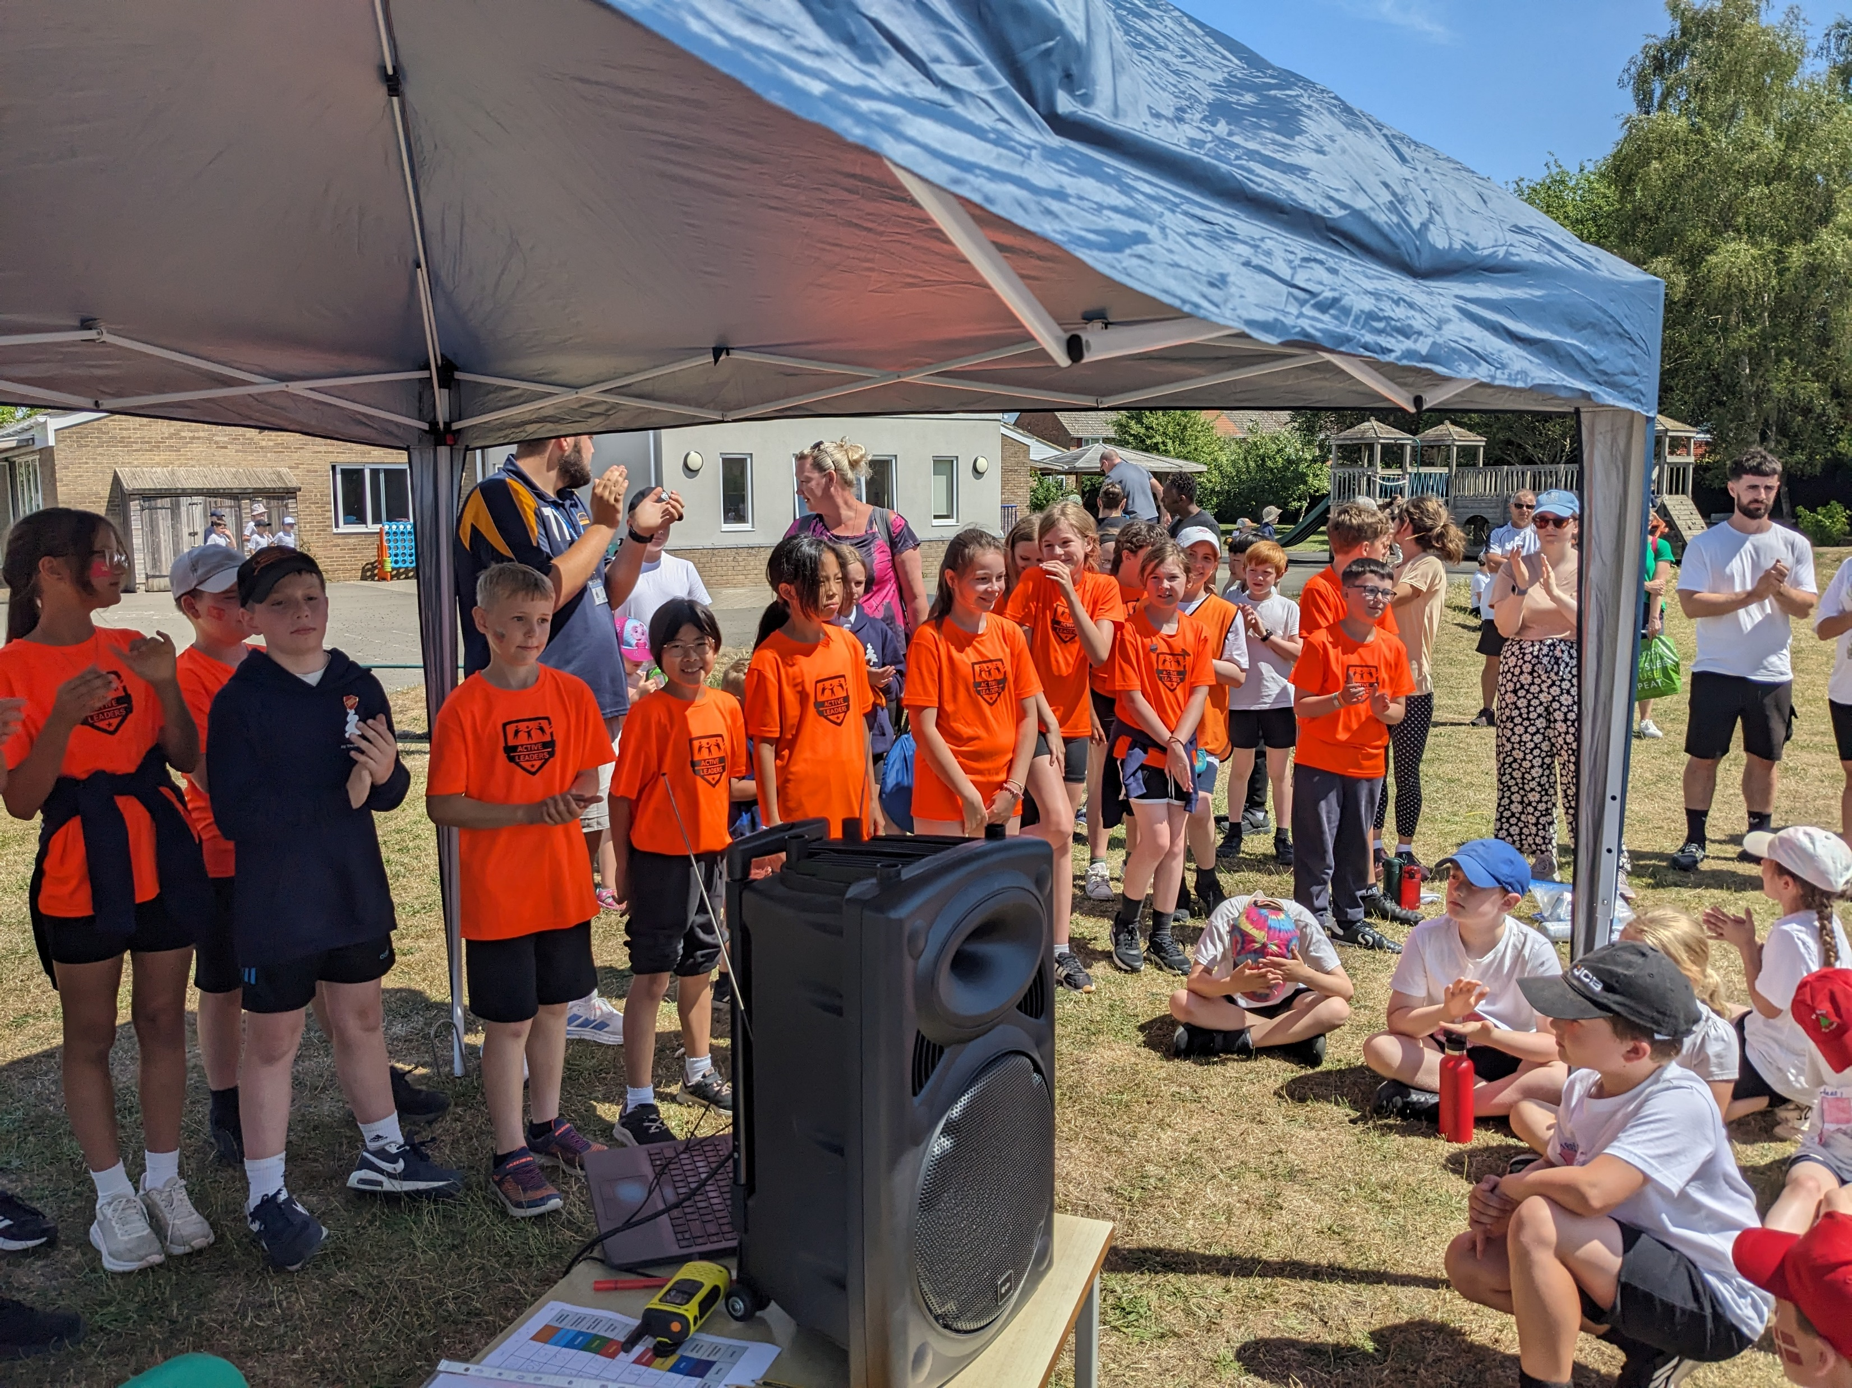
Active Leaders
30 of our Year 6’s trained to become Active Leaders
Daily playtime sessions for Year 3/4 run by Active Leaders
Active Leaders heavily involved in the running of Sports Day for Years 3 & 4
Mr Mule has attended Active Leader training (free of charge) to enable him to run the sessions next year.
Our Active Leaders were used in the promotional video that is shown to other schools.

Slide 3
CPD for Staff
Re-purchase of the PE Hub scheme
CPD for all staff with Mr Mule
Year 3 Term 1 Netball (Mrs Giles & Miss Raheem)
Year 4 Term 2 Hockey (Mrs Baker & Miss Hutchings)
Year 6 Term 3 Tag Rugby (Miss Jordan & Mrs Downs)
Year 5 Term 4 Cricket (Mrs Ash & Miss Lloyd)
Year 3 Term 5 Cricket (Mrs Giles & Miss Raheem)

Slide 4
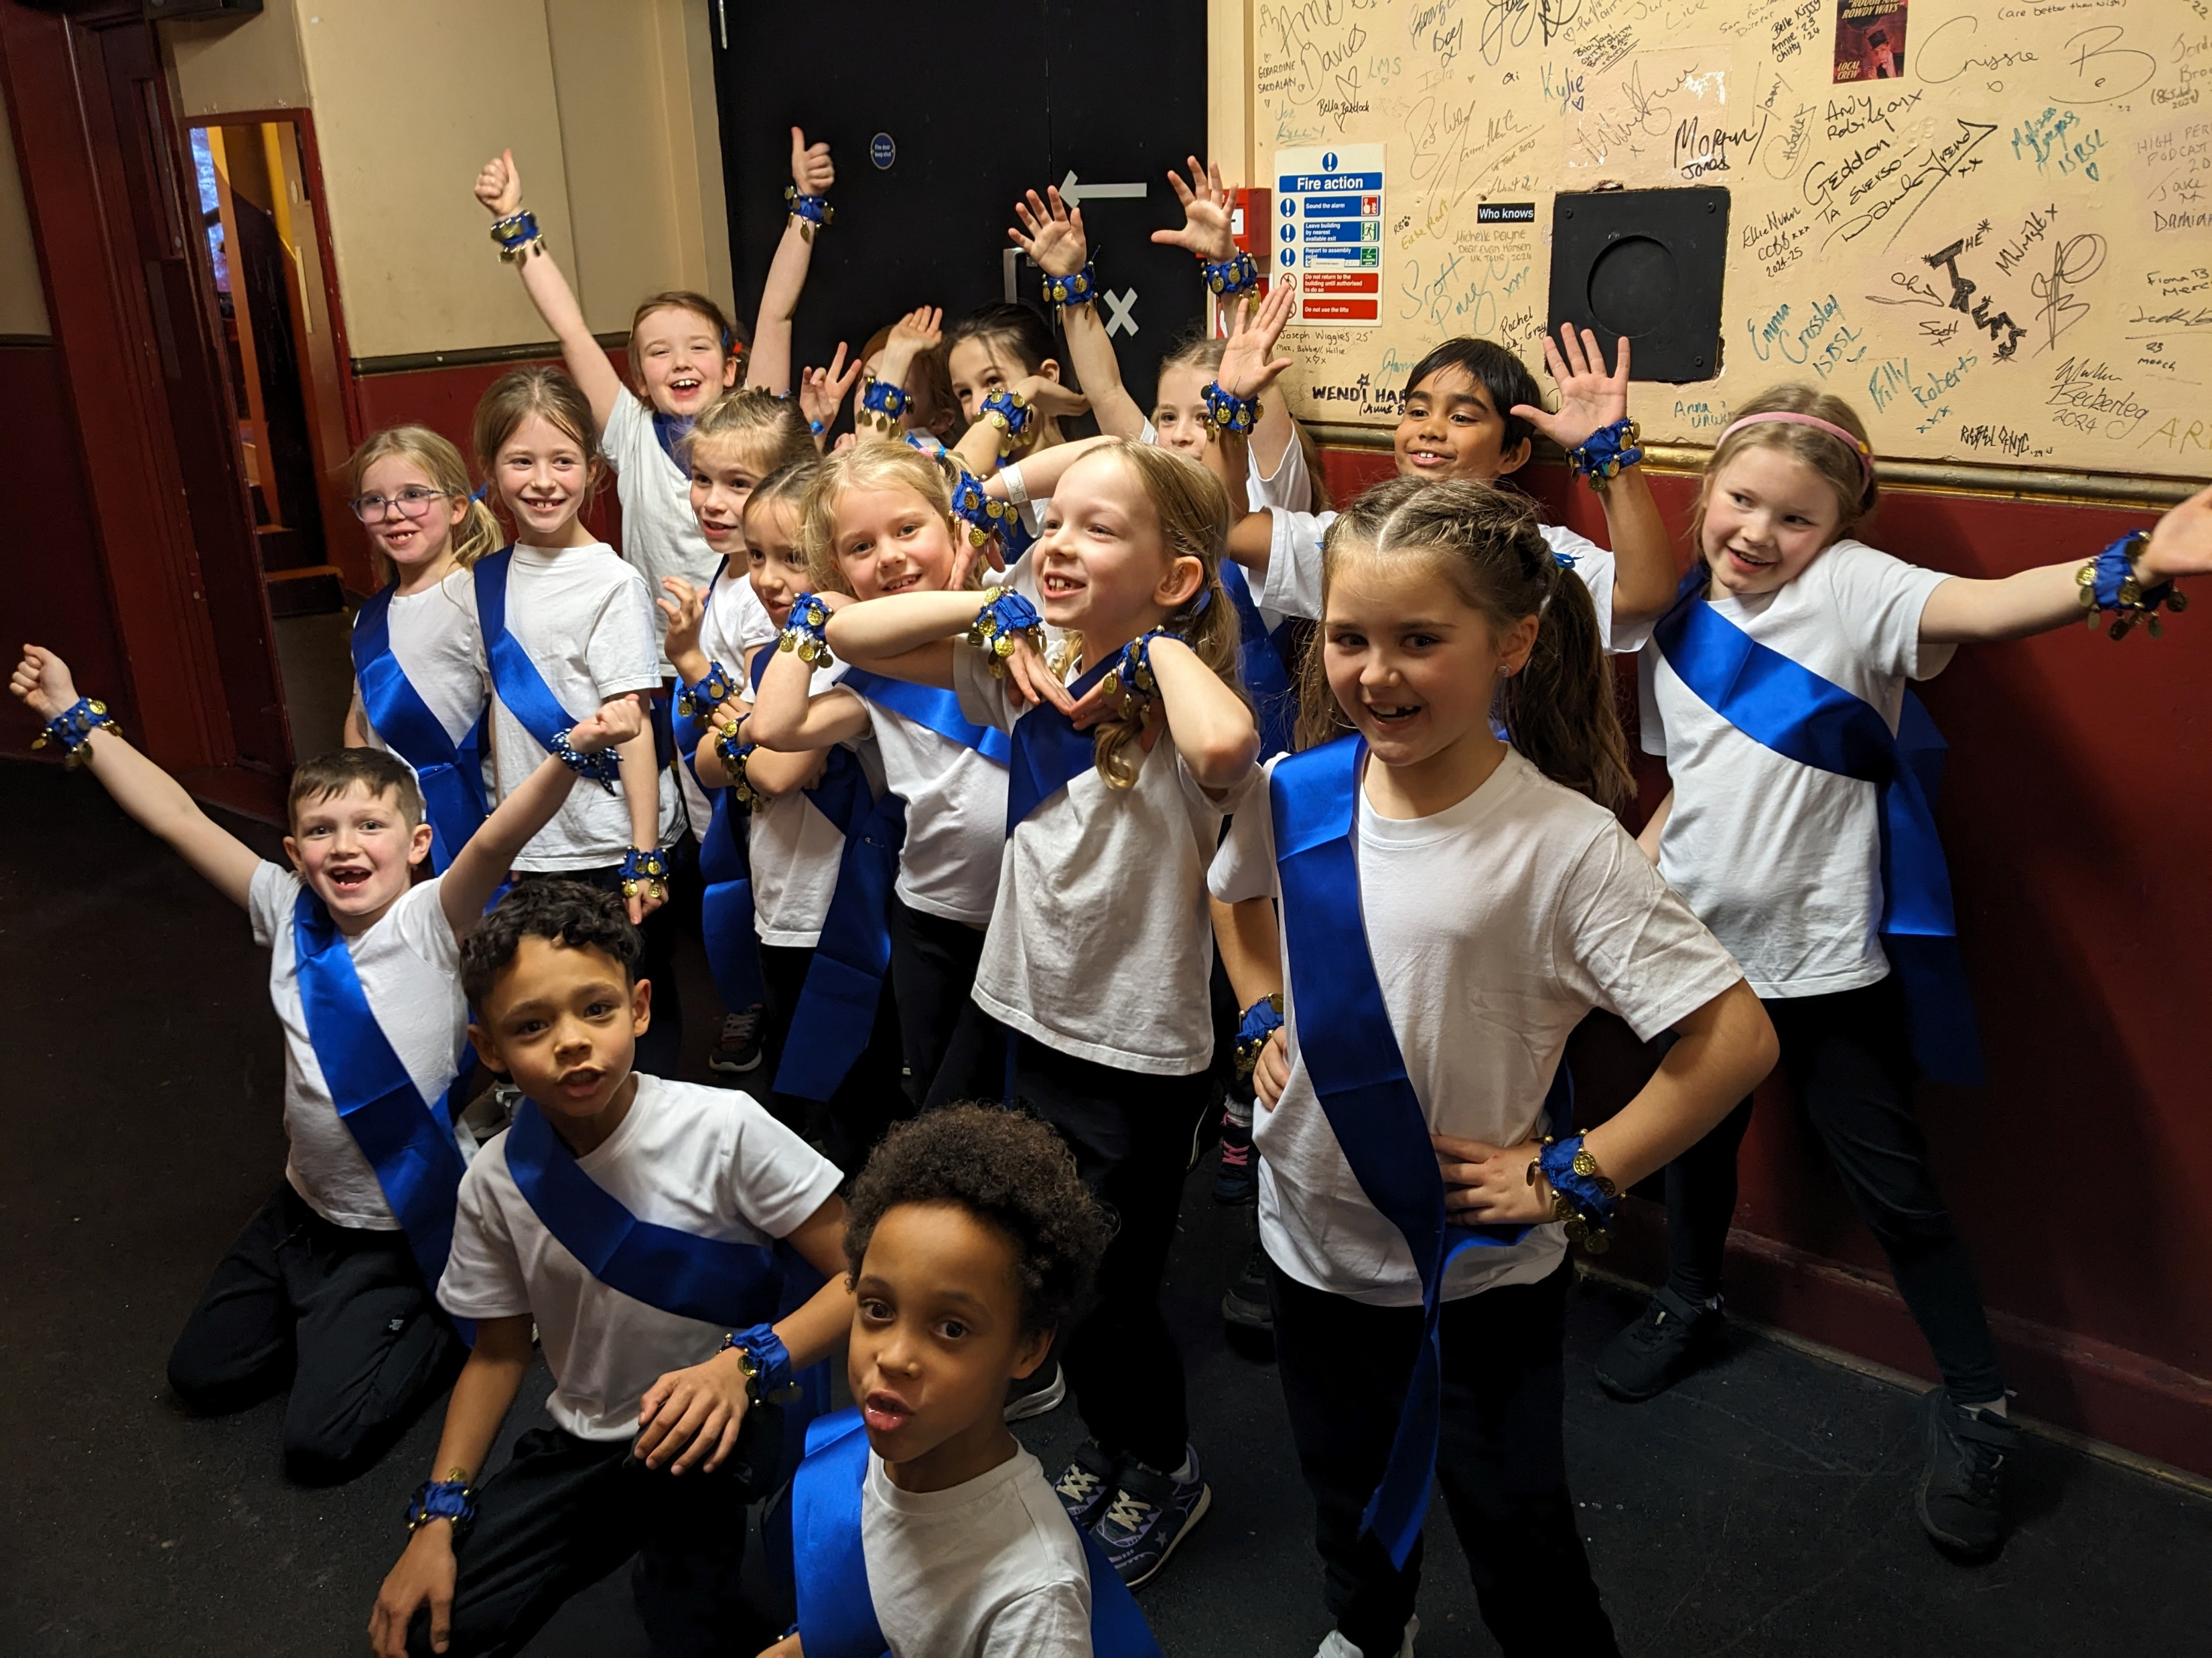
Dance
Dance CPD for our Year 3 and Year 4 Teachers with Emma Seymour
6 week block of lessons for our Year 3 and Year 4 classes (4 classes in total)
After school dance club (4 sessions)
Twenty of our dancers attended the Oxfordshire School Dance Festival at the New Theatre.
Transport provided for all dancers to attend the event.

Slide 5
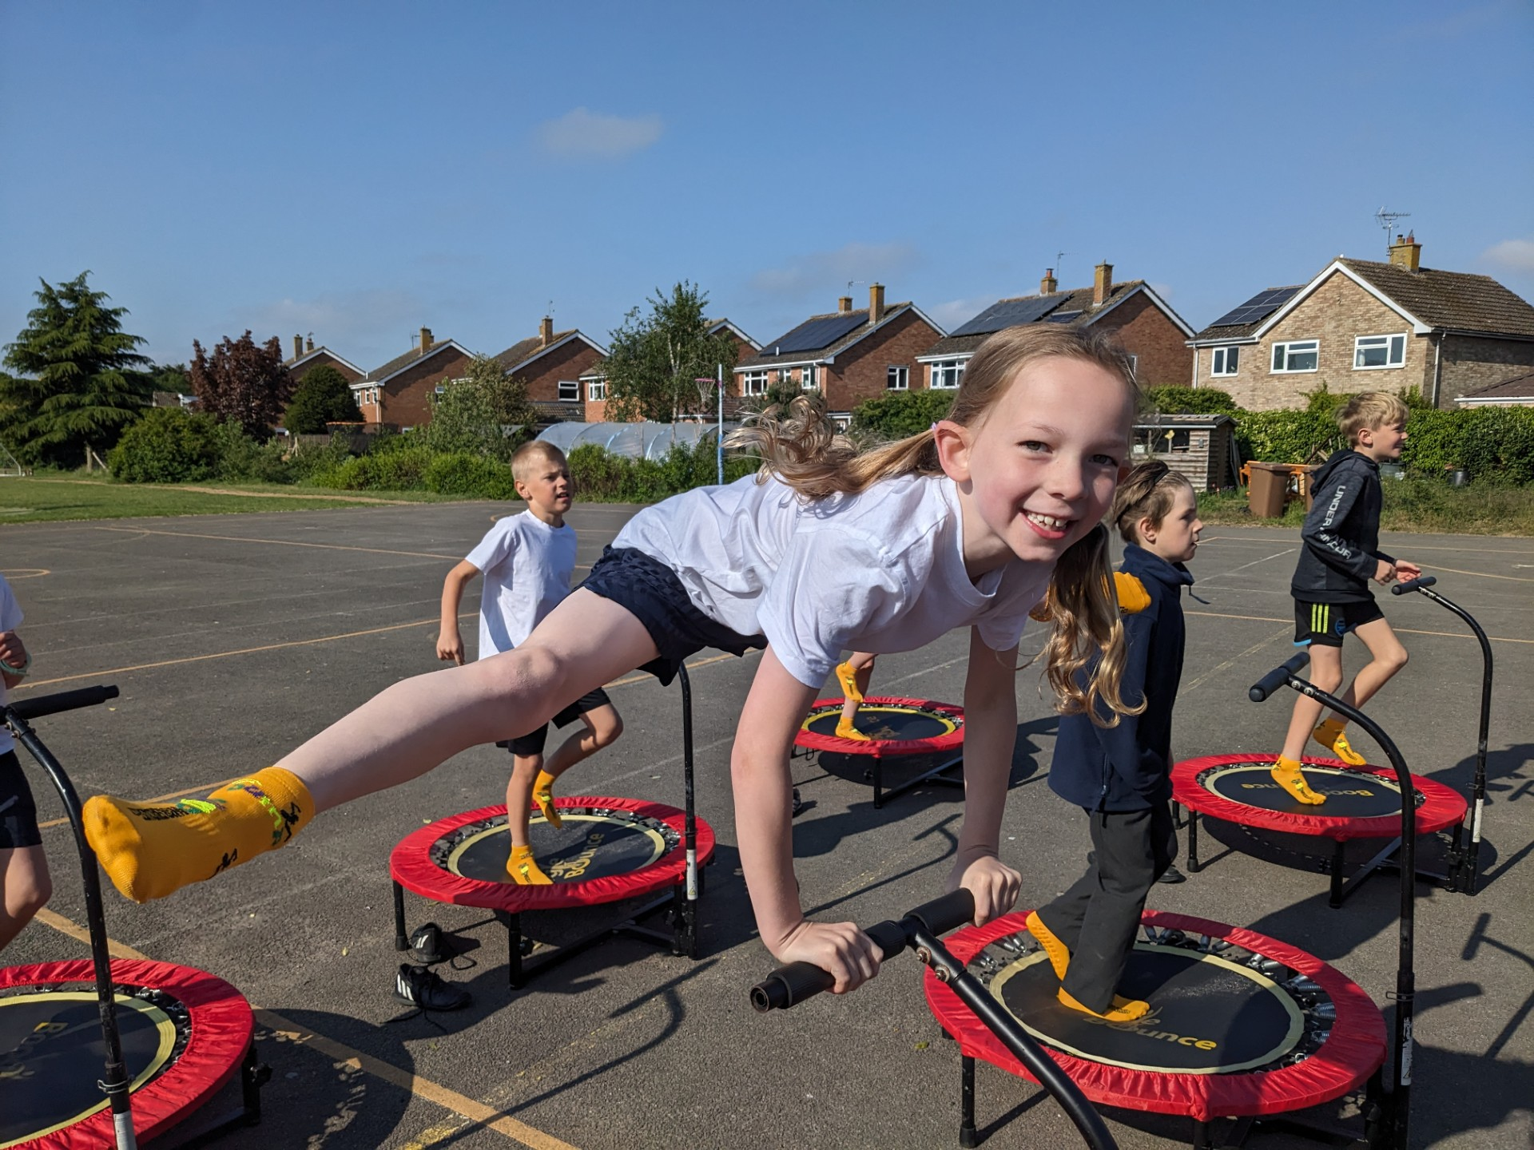
Boogie Bounce
Every year, we try to find something a bit different to encourage children to get/stay active. We understand that not everyone likes ‘team’ games and traditional sports. We work on the principle that there is something for everyone and we just need to find out what it is. This year, we opted for aerobic trampolining.
‘It was the best day of my life!’ George, Year 3

Slide 6
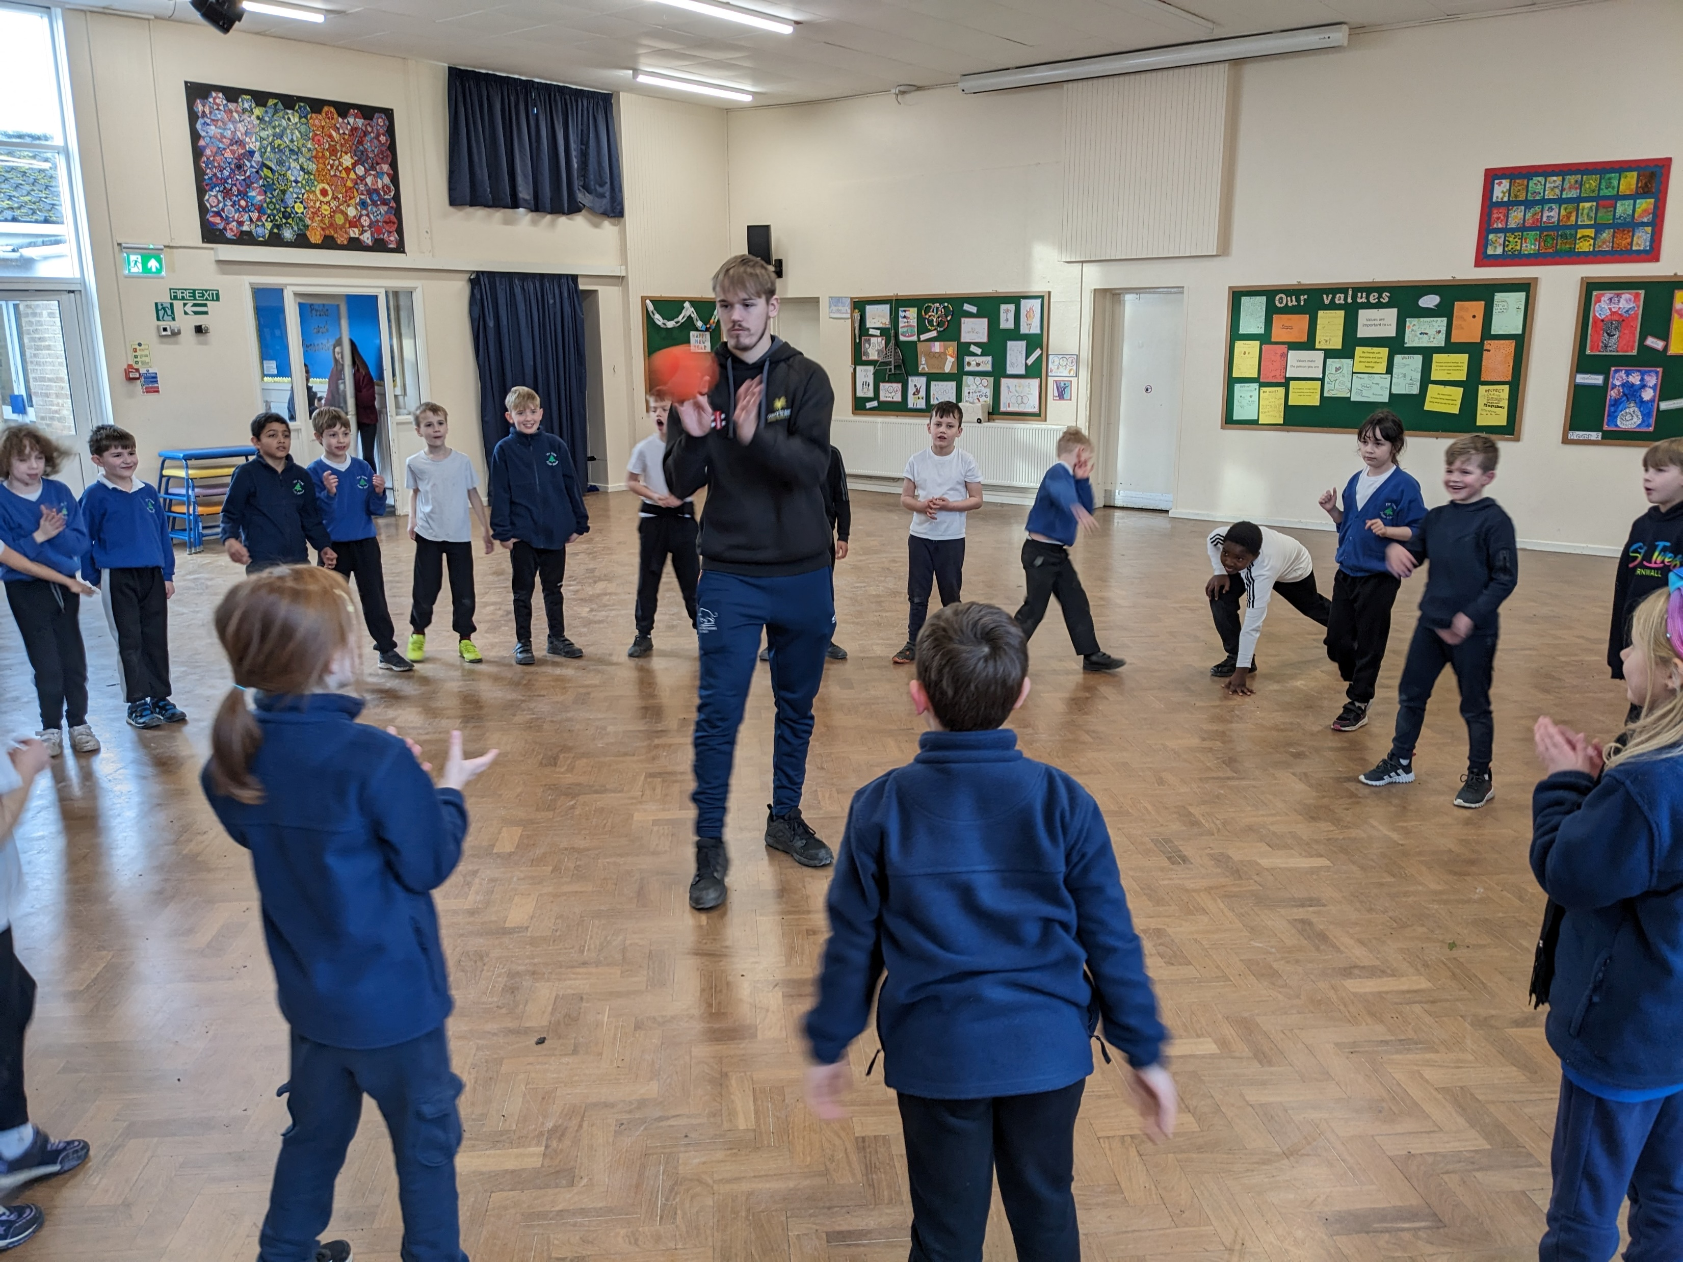
Chance to Shine Cricket
Chance to Shine cricket CPD for Year 3 and 4 staff
6 week block of cricket lessons run by Chance to Shine for Years 3 & 4. Year 3 sessions were provided free of charge.

Slide 7
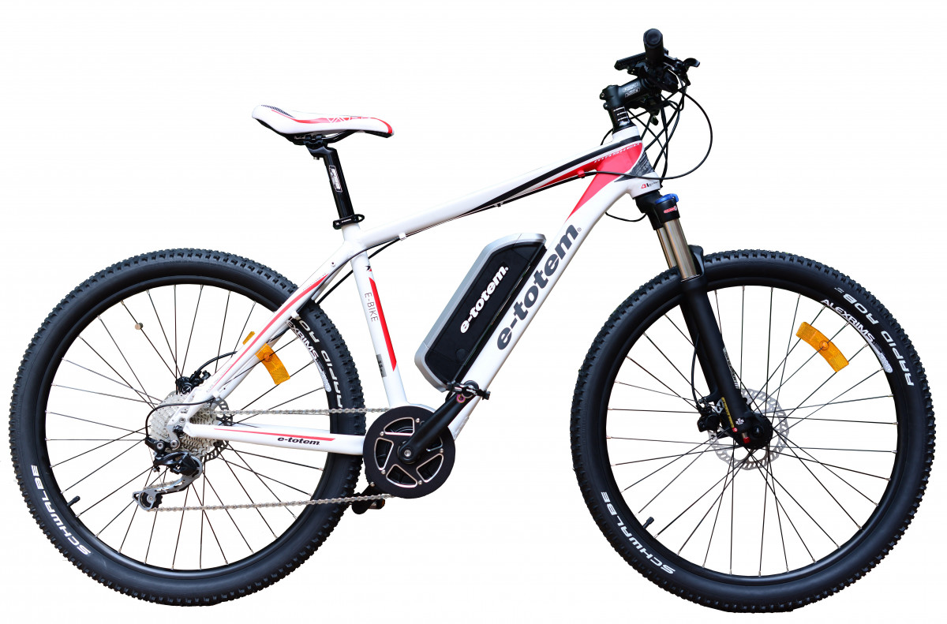
Bikeability
56/59 children passed their Bikeability training (Level 1 and 2)

Slide 8
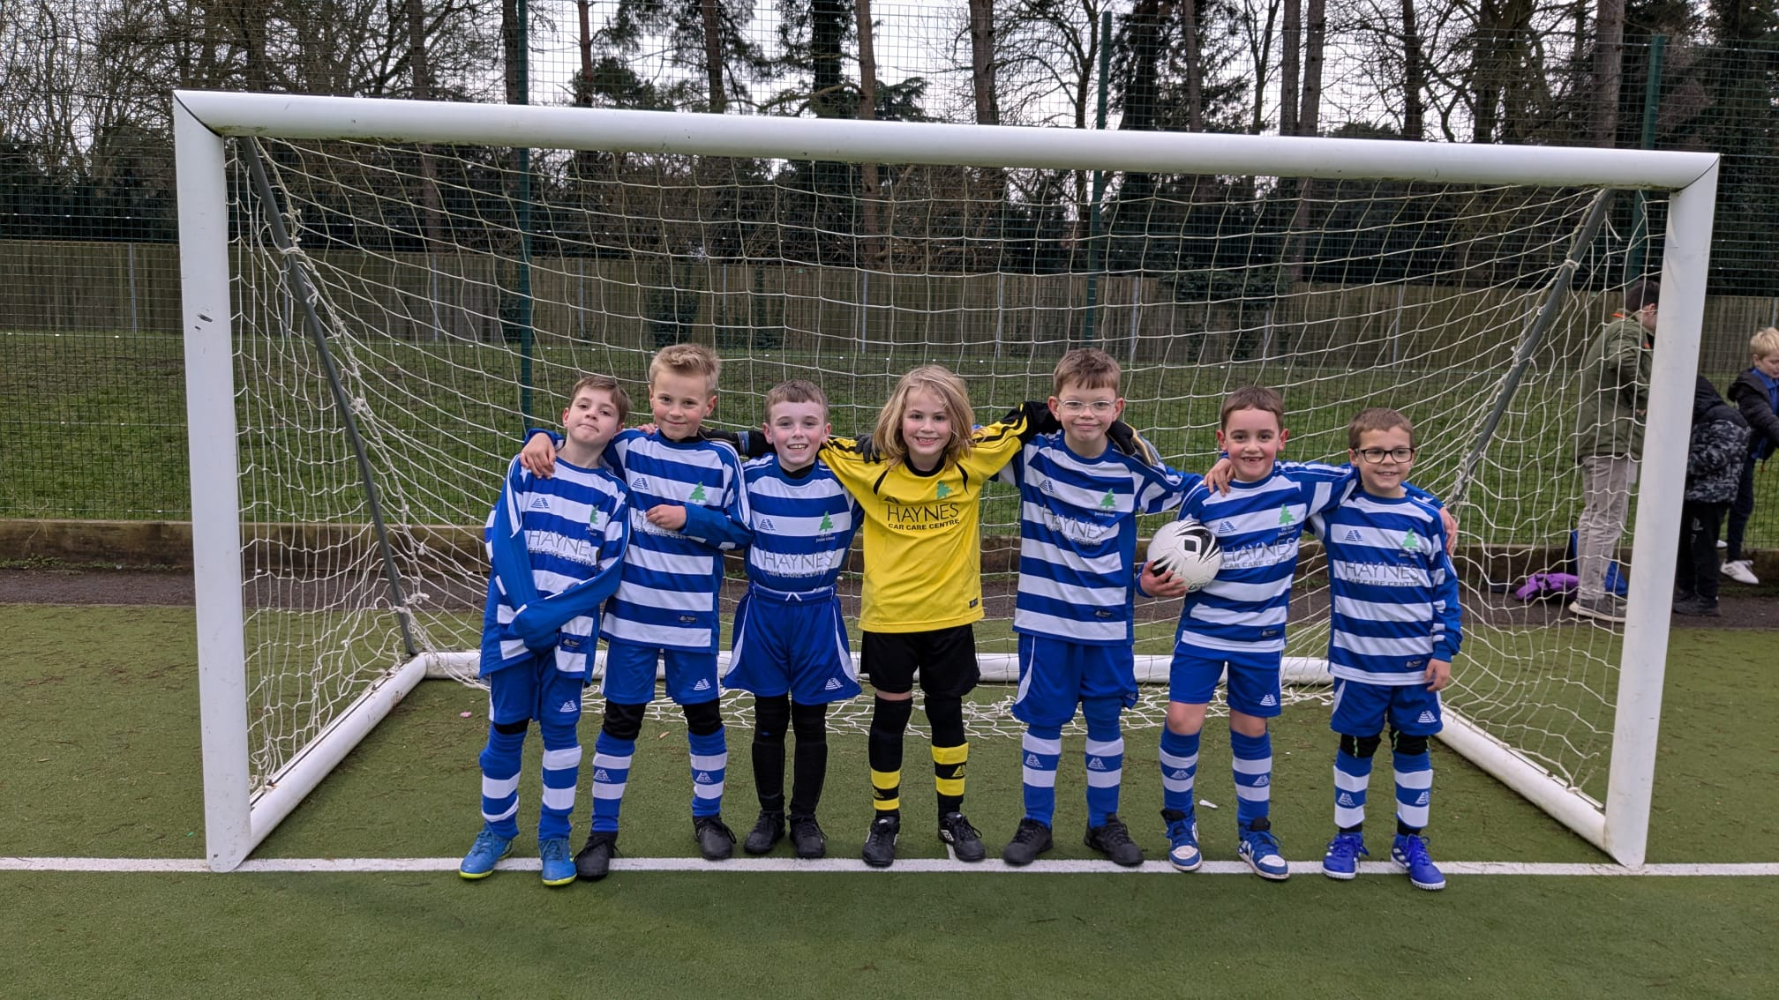
Tournaments
SD organised/hosted the annual meeting for PE subject leads to plan dates.
SD has organised all partnership football tournaments (3 in total)
Fir Tree has attended 10 partnership tournaments this year
Fir Tree has taken 21 Teams to partnership tournaments
Our Year 5/6 netballers (A team) won the partnership tournament and got through to the South Oxfordshire finals.
Our Year 3/4 and our Year 5/6 girls won the Tag Rugby tournaments

Slide 9

Swimming
94% of our Year 6 children are able to confidently swim the 25m government target
We introduced swimming for Year 4’s this year. The idea being that if they start younger, our 94% target may increase because water confidence may be higher by the time they reach Year 6.

Slide 10
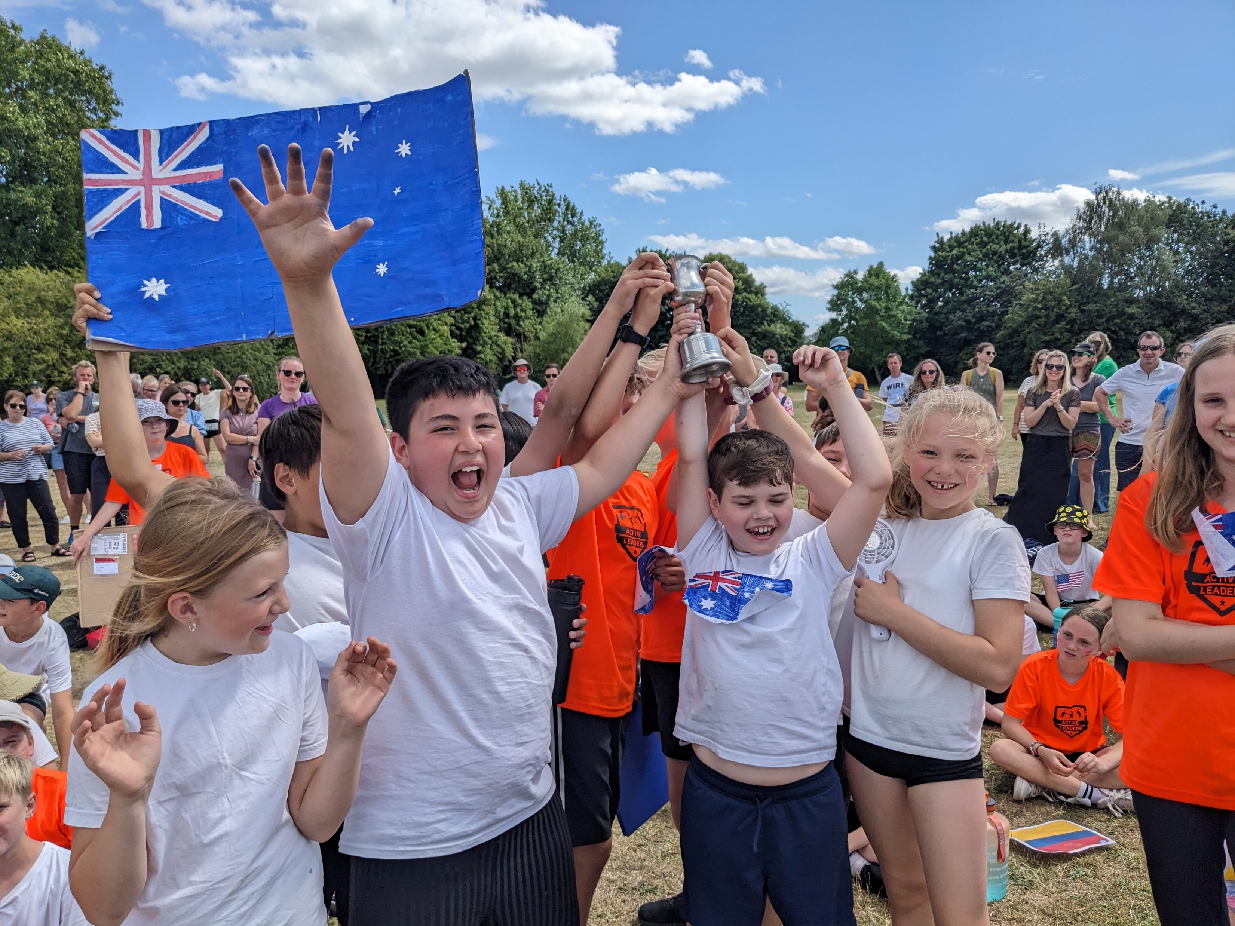
Sports Day
Sports day 2025 was a successful day. Well done to our winning Body smart and People smart teams: Australia, Argentina, Italy & Sweden
From: Jacky Mattam <jackymattam@btinternet.com>
Sent: 27 June 2025 15:45
To: Claire Archer <office.2578@fir-tree.oxon.sch.uk>
Subject: Sport's day
Dear Fir Tree
I attended the school's sports day today and was impressed by the hard work which had gone into
making it enjoyable for everyone.
Well done Fir Tree!
Regards
Doting Grandparent

Slide 11
Sport Premium
£1250 External CPD for staff with Chance to Shine cricket and dance with Emma Seymour
£4271 Internal CPD for staff with Nathan Mule
£544 Online/resource development with Active Maths & The PE Hub
£1200 Internal school based extra-curricular opportunities (After school clubs run by Nathan Mule)
£1200 Broadening aquatic opportunities for pupils (additional lifeguard)
£1205 Swimming travel shortfall from parents
£1350 Internal equipment and resources
£350 Overtime costs for staff attending tournaments (separate to TOIL)
£1950 External coaching staff 5 day Active Leader course
Total spend to date: £13,320

Slide 12
PE Clubs After school:
This year we have run the following clubs:
Dance
Football
Multisports
Tag Rugby
Rounders

