Slide 1

Fir Tree
Safer Internet Day 2024

Slide 2


Can you guess the children’s book from the emoji sentence?
For example, this would be Goldilocks and the Three Bears:

Slide 3




1
Charlie and the chocolate factory
By Roald Dahl

Slide 4






2
The Very Hungry Caterpillar
By Eric Carle

Slide 5



3
The Lion the Witch and the Wardrobe
By C. S. Lewis

Slide 6



4
Paddington Bear
By Michael Bond

Slide 7


5
The Tiger Who Came To Tea
By Judith Kerr

Slide 8



6
Green Eggs and Ham
By Dr Seuss

Slide 9

True or False?
If something is posted online it will be there forever.

Slide 10

True!
All information posted online will stay there forever.
This could be many things including: pictures, videos, comments, group chats, search history, emails, gaming history and much more…

Slide 11

Why is this important to know?
We need to be careful about what information we share online.
Including: pictures, videos, comments, messages and personal information.

Slide 12

Fir Tree Safer Internet Day Challenge:
Mission A:
Year 3
Mission B:
Year 4
Mission C:
Year 5
Mission D:
Year 6

Slide 13


Fir Tree
Safe Password Competition

Slide 14

What makes a strong password?

Slide 15
https://www.youtube.com/watch?v=aEmF3Iylvr4

Slide 16
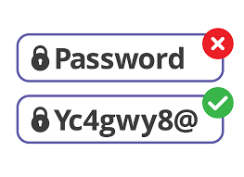
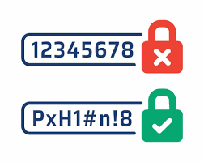
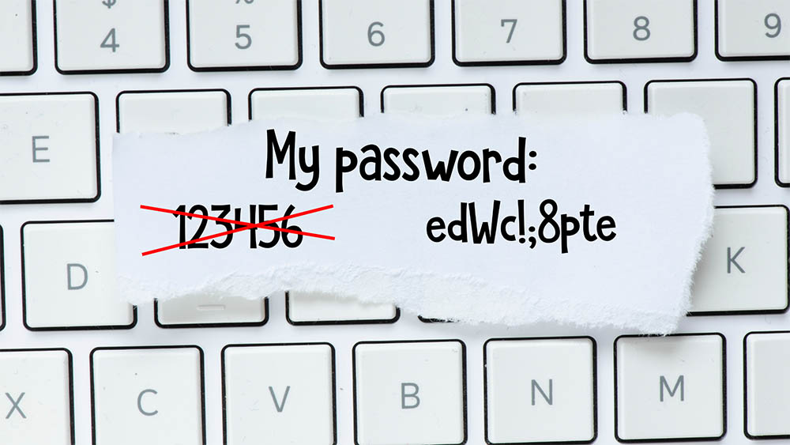
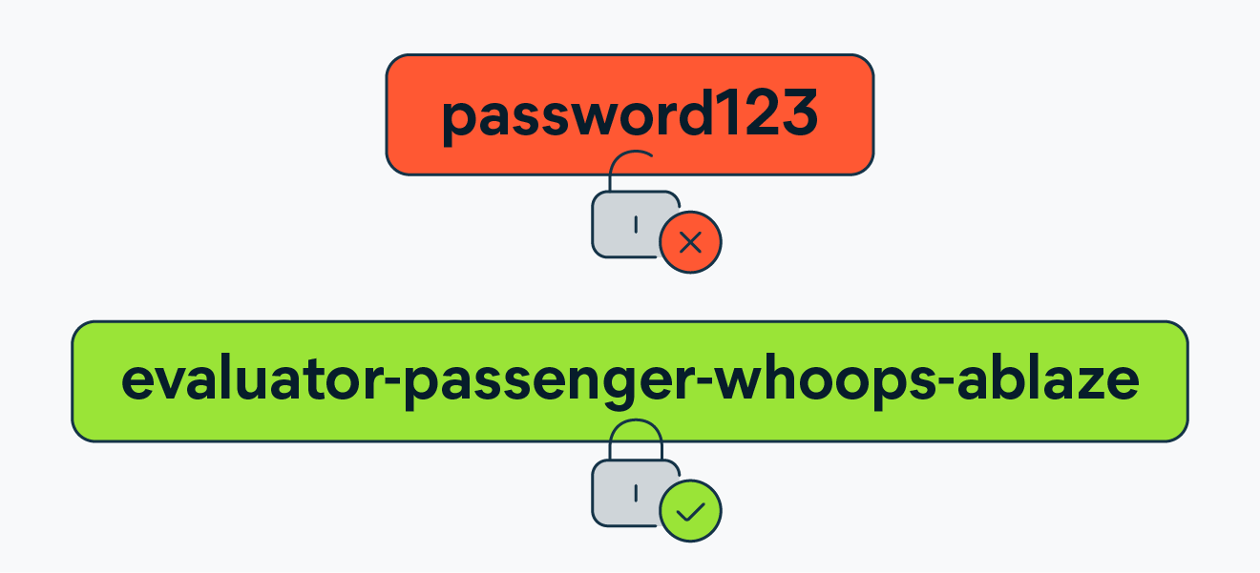
S2S Checklist:
8 – 14 characters in length. The longer the better.
Include numbers, symbols, capital letters and lower case letters – mix these up.
Avoid personal information such as: birthdays, address, phone number, pets names.
Not dictionary words or usual combinations of words: Firefighter
Avoid using obvious substitutes: H0use.
Use a sentence to remember your password: Jack and Jill Went Up The Hill: JAJWUTH

Slide 17

How do I enter?
Write your password idea on a spare piece of paper.
Include your:
Full Name
Year
Class
Bonus points for people who explain why they’ve chosen that password.
The strongest 3 passwords will be chosen by Mr Knight and awarded a prize.
Competition open until: Wednesday 14th February 2024
The password box will sit in the library where you can enter your idea.
Note: DO NOT USE THIS PASSWORD ONCE ENTERED!

Slide 18


Good Luck!

